Slide 1



Google Firebase
Creation of Google Firebase real-time database
Credentials of the database
Pushing data from Arduino framework to Firebase
Pulling data from Firebase to Arduino framework

Slide 2


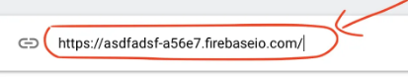
Google Firebase
Google Firebase Real Time Database is a cloud hosted database
Log in can be done using your Gmail id
The Real Time Database is a NoSQL database and has only key-value pairs
Firebase Real Time Database credentials –
Host name
Database secret
Key | Value
Temperature | 30.7
Humidity | 87
Window status | Open
Motor status | ON

Slide 3
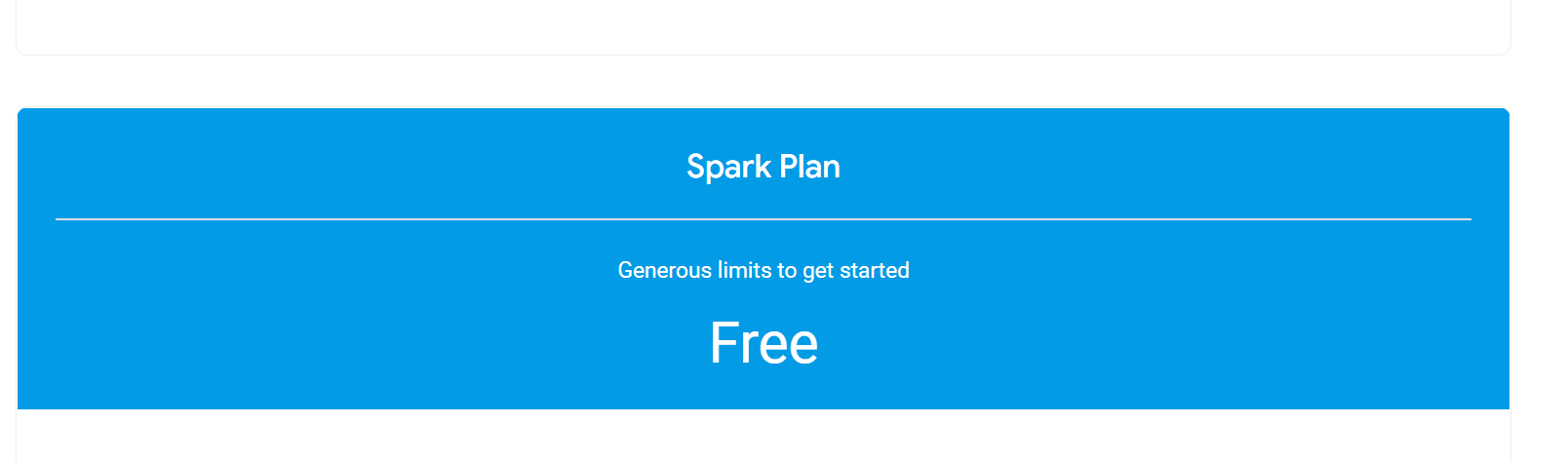
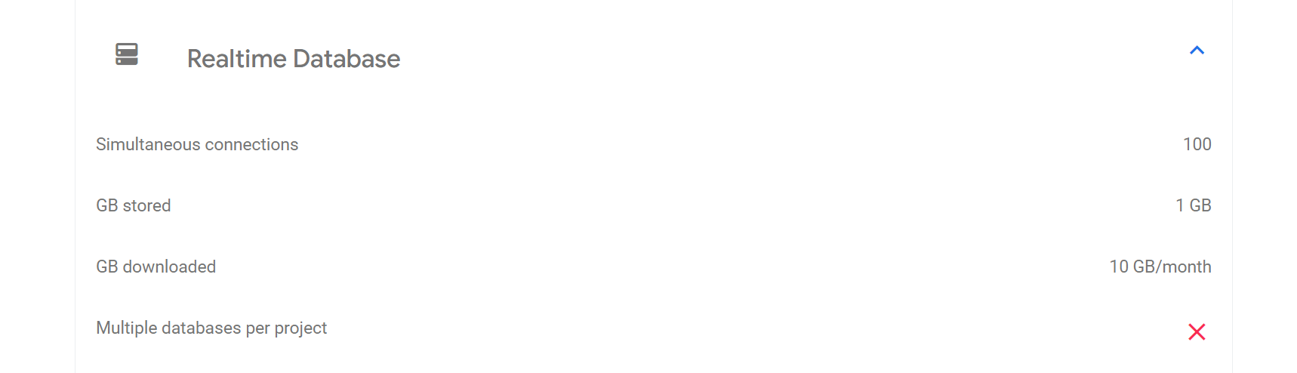
Google Firebase

Slide 4
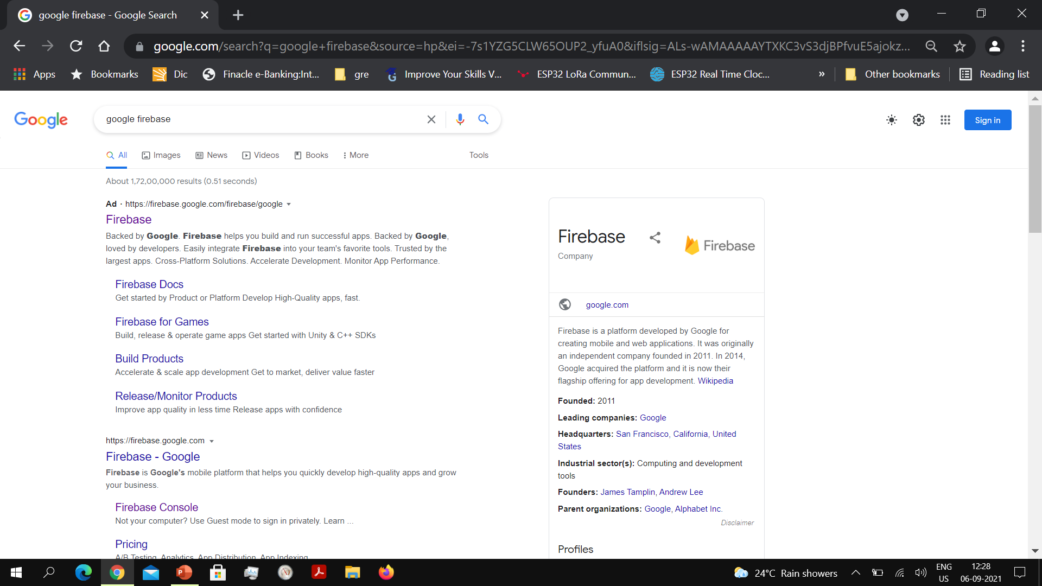
Type in Google Firebase in Google and select Firebase

Slide 5
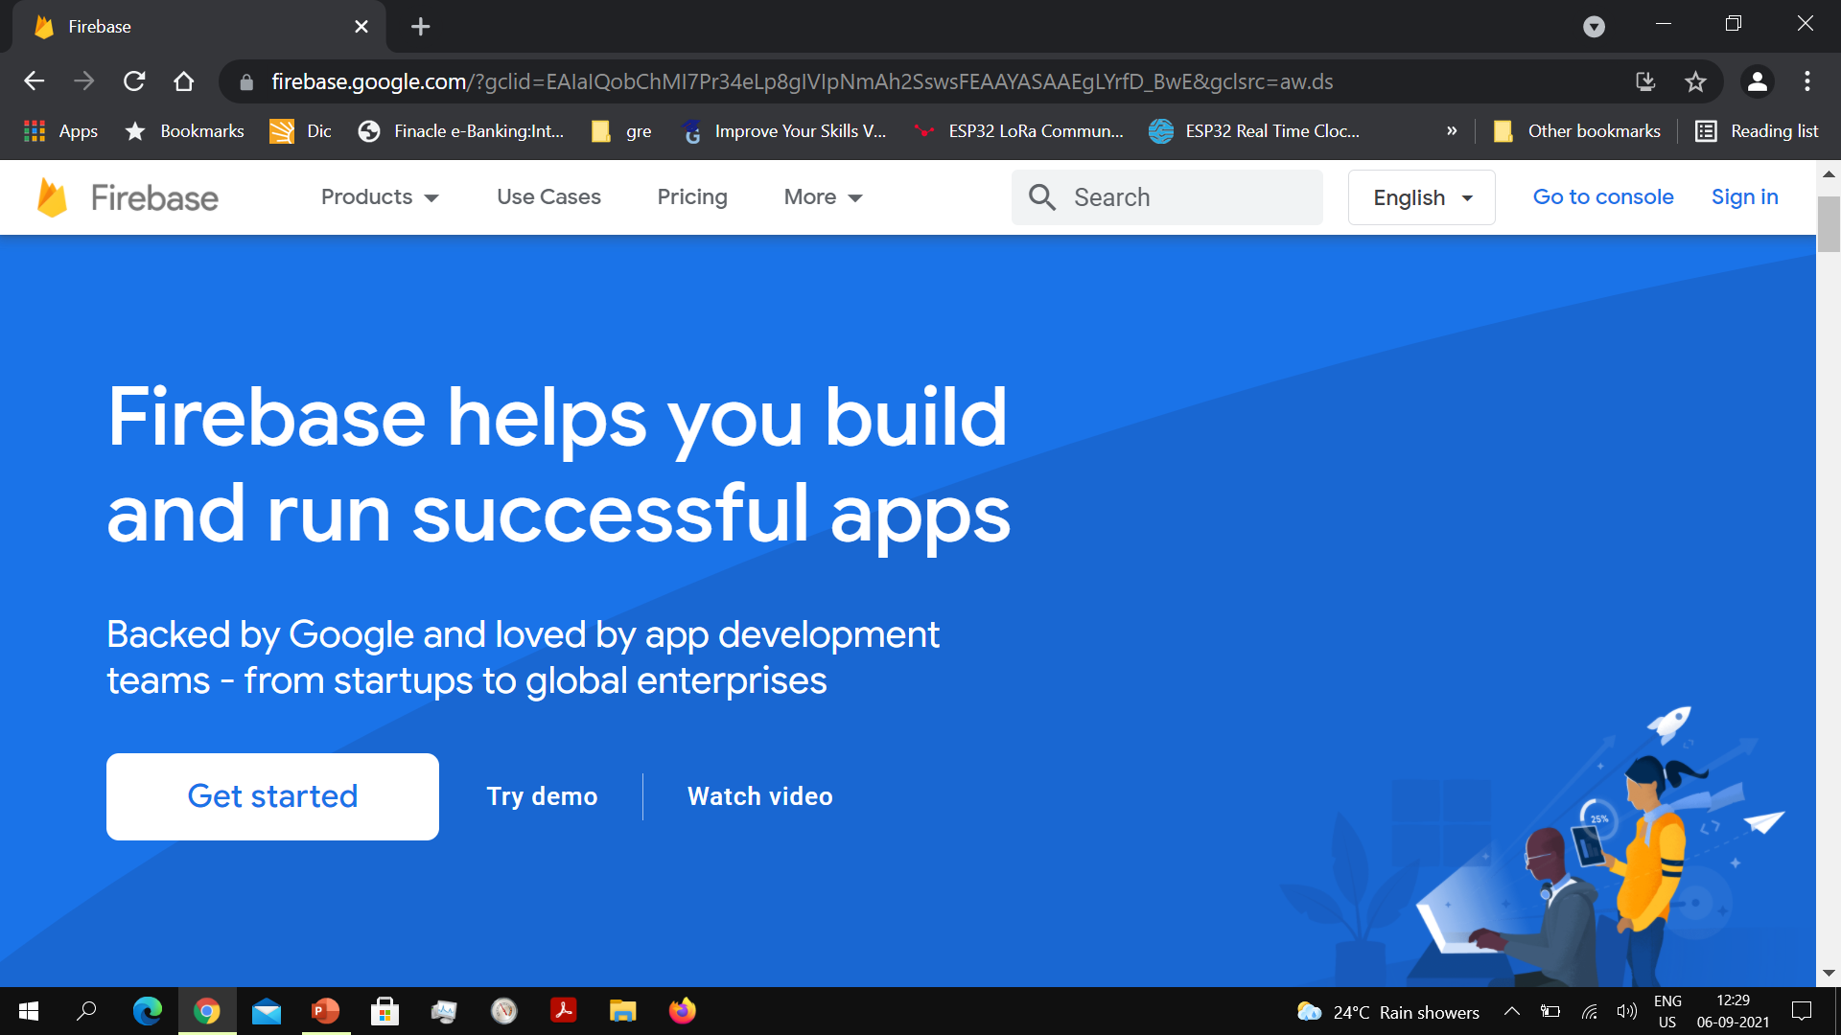
Get Started screen opens up
Click on Get Started button

Slide 6
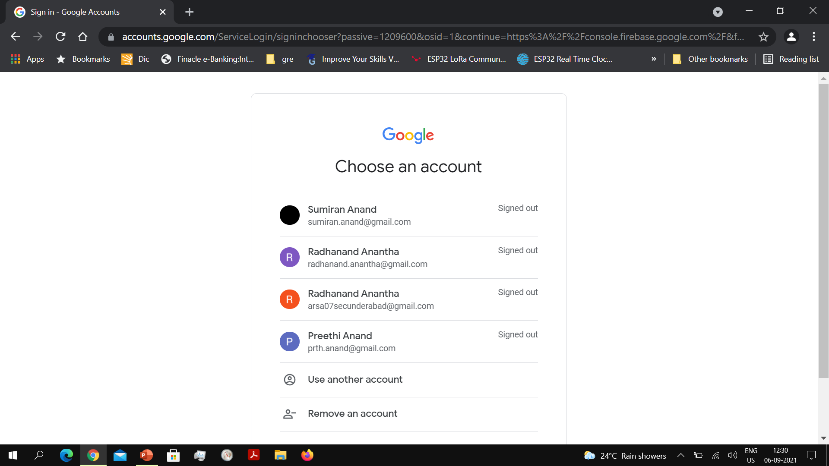
Log in using your Gmail account

Slide 7
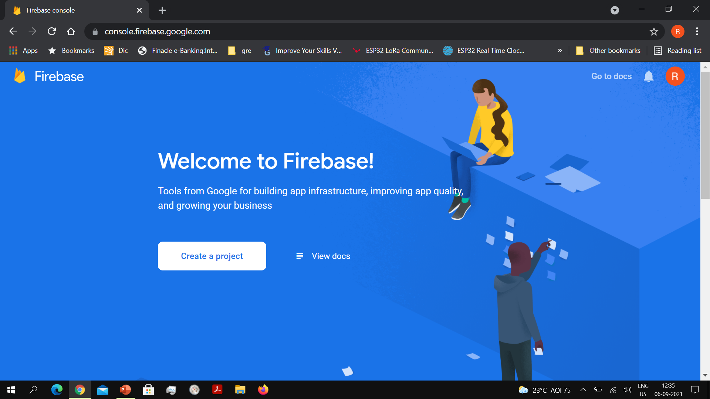
Welcome screen of Firebase
Click on the Create Project button

Slide 8
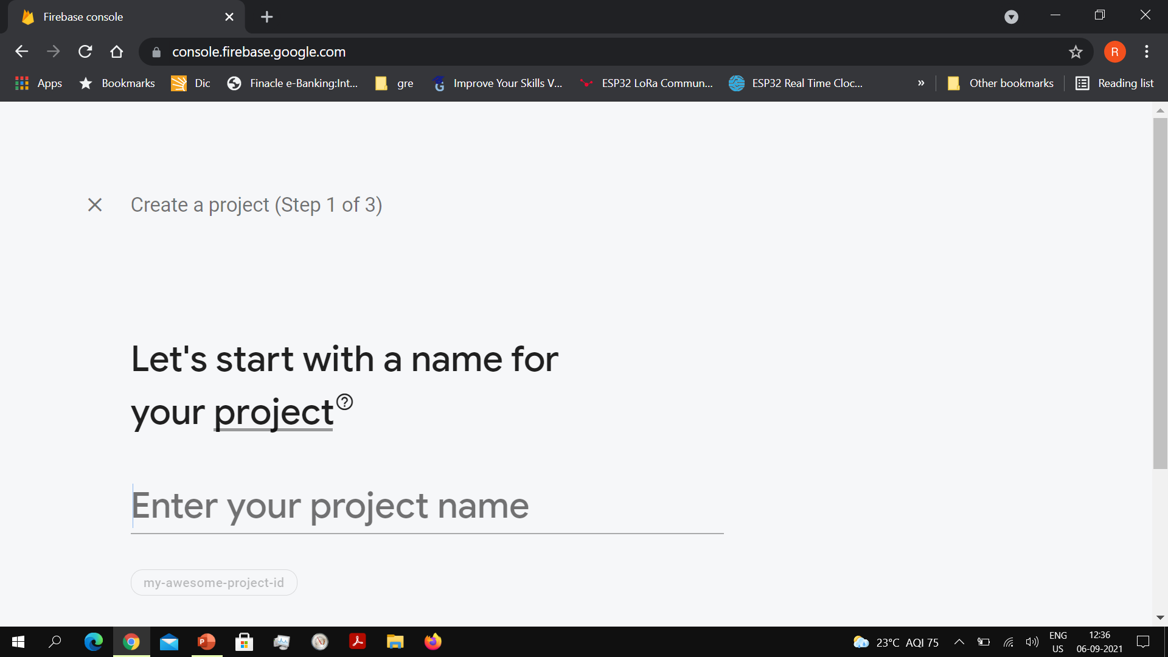
Create just one Firebase project
The free Spark plan has a limit on the number of projects you can create

Slide 9
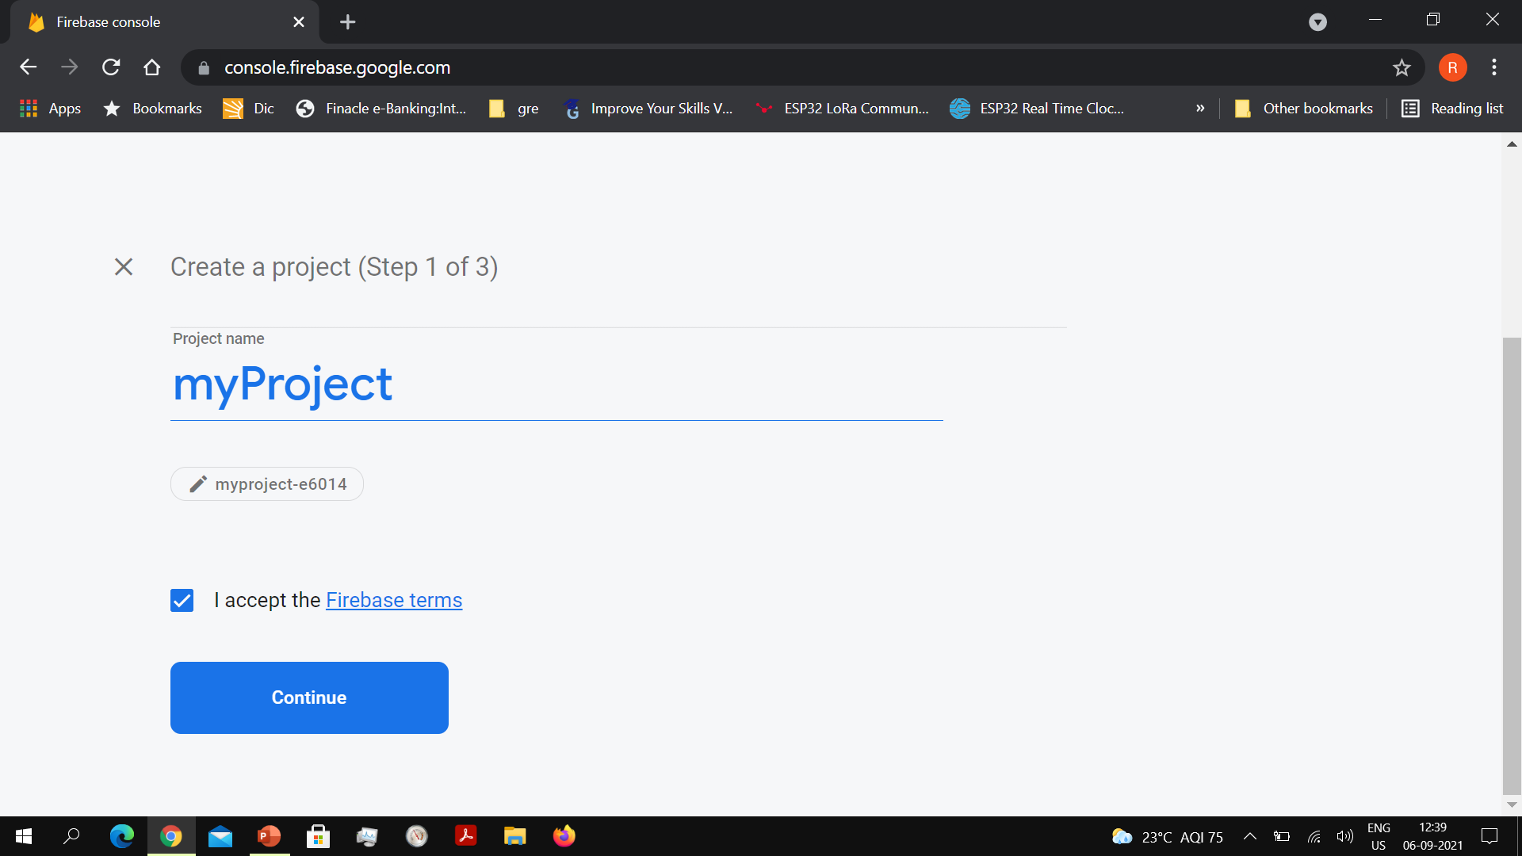
Type in your project name and accept the Firebase terms

Slide 10
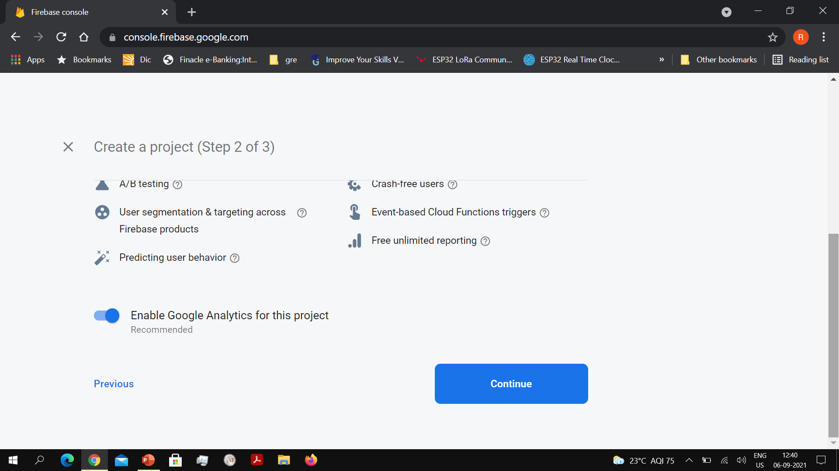

Slide 11
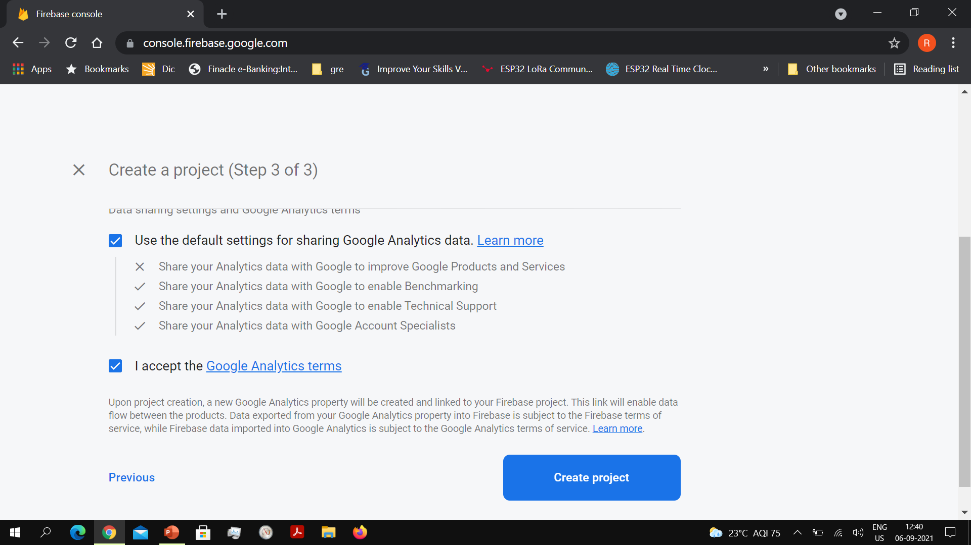

Slide 12
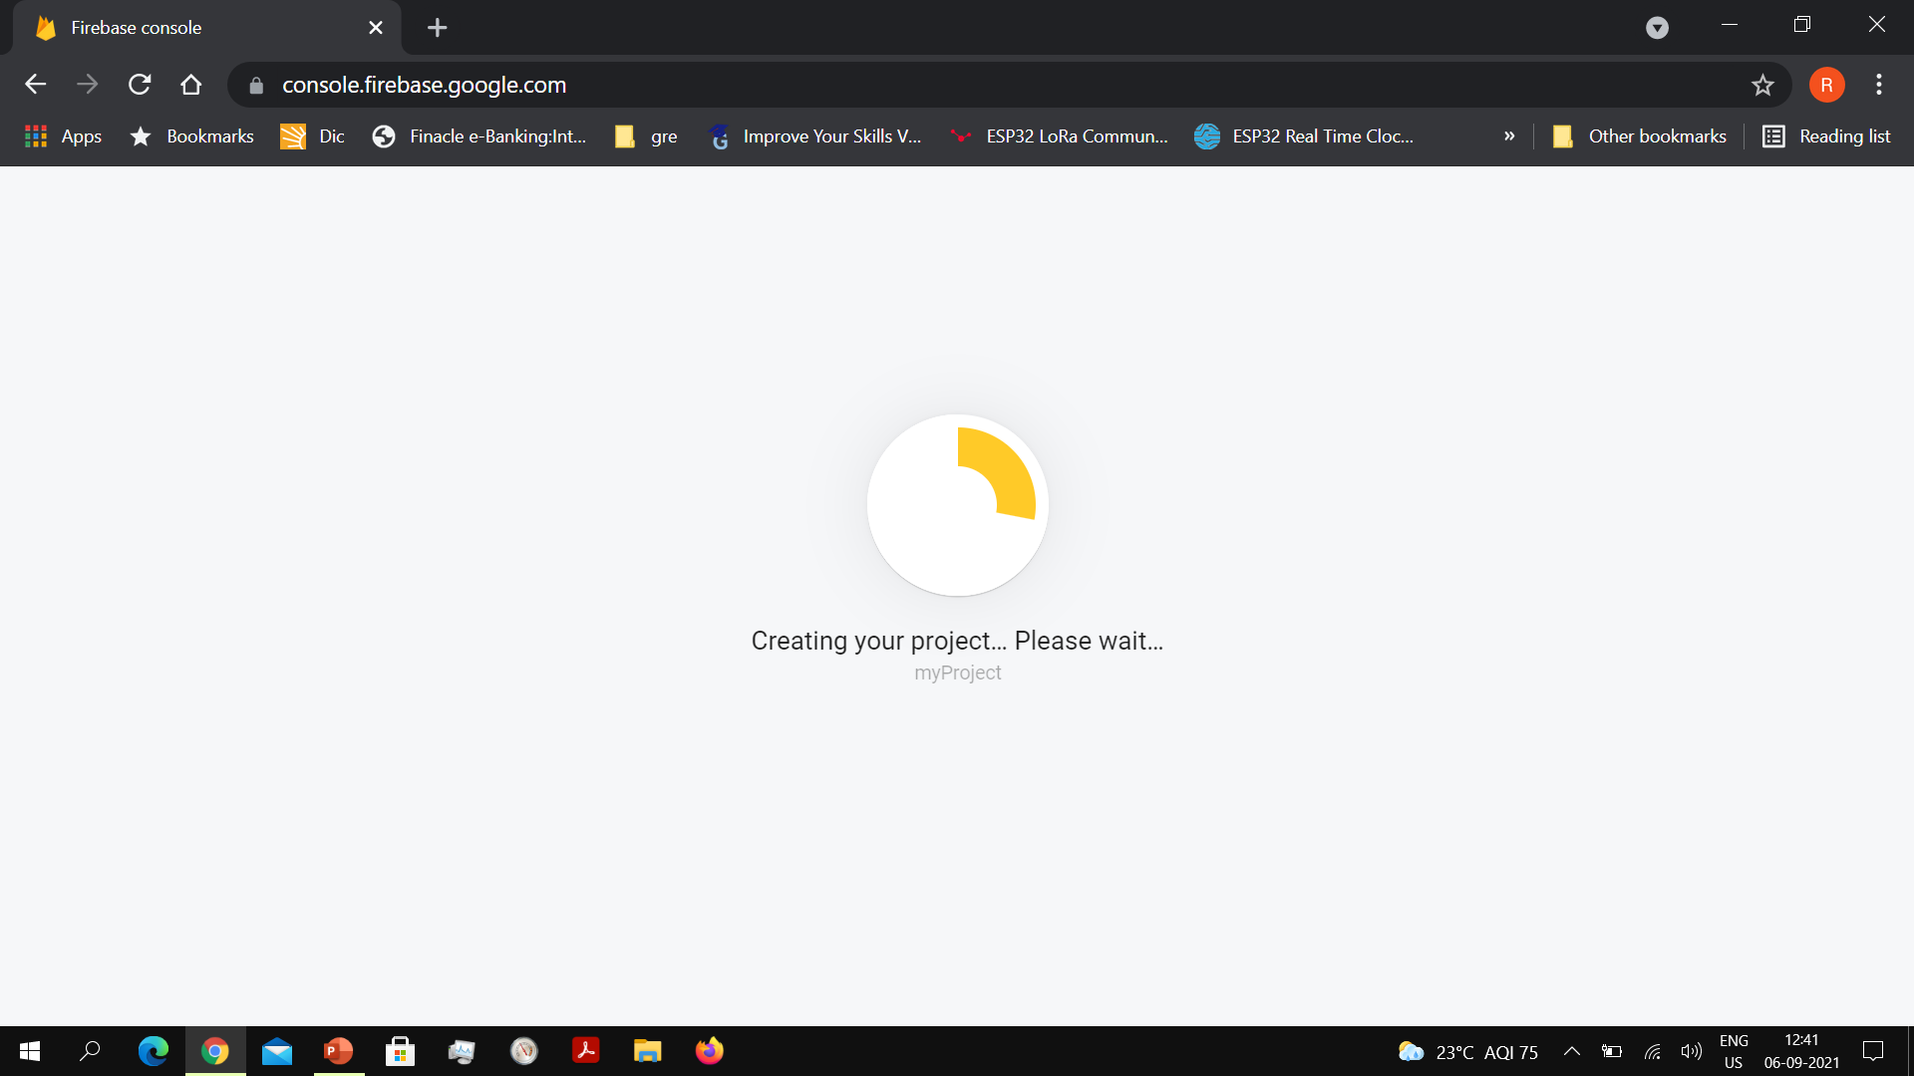
Creating your project may take a while
Wait till your project is created and you get a prompt

Slide 13
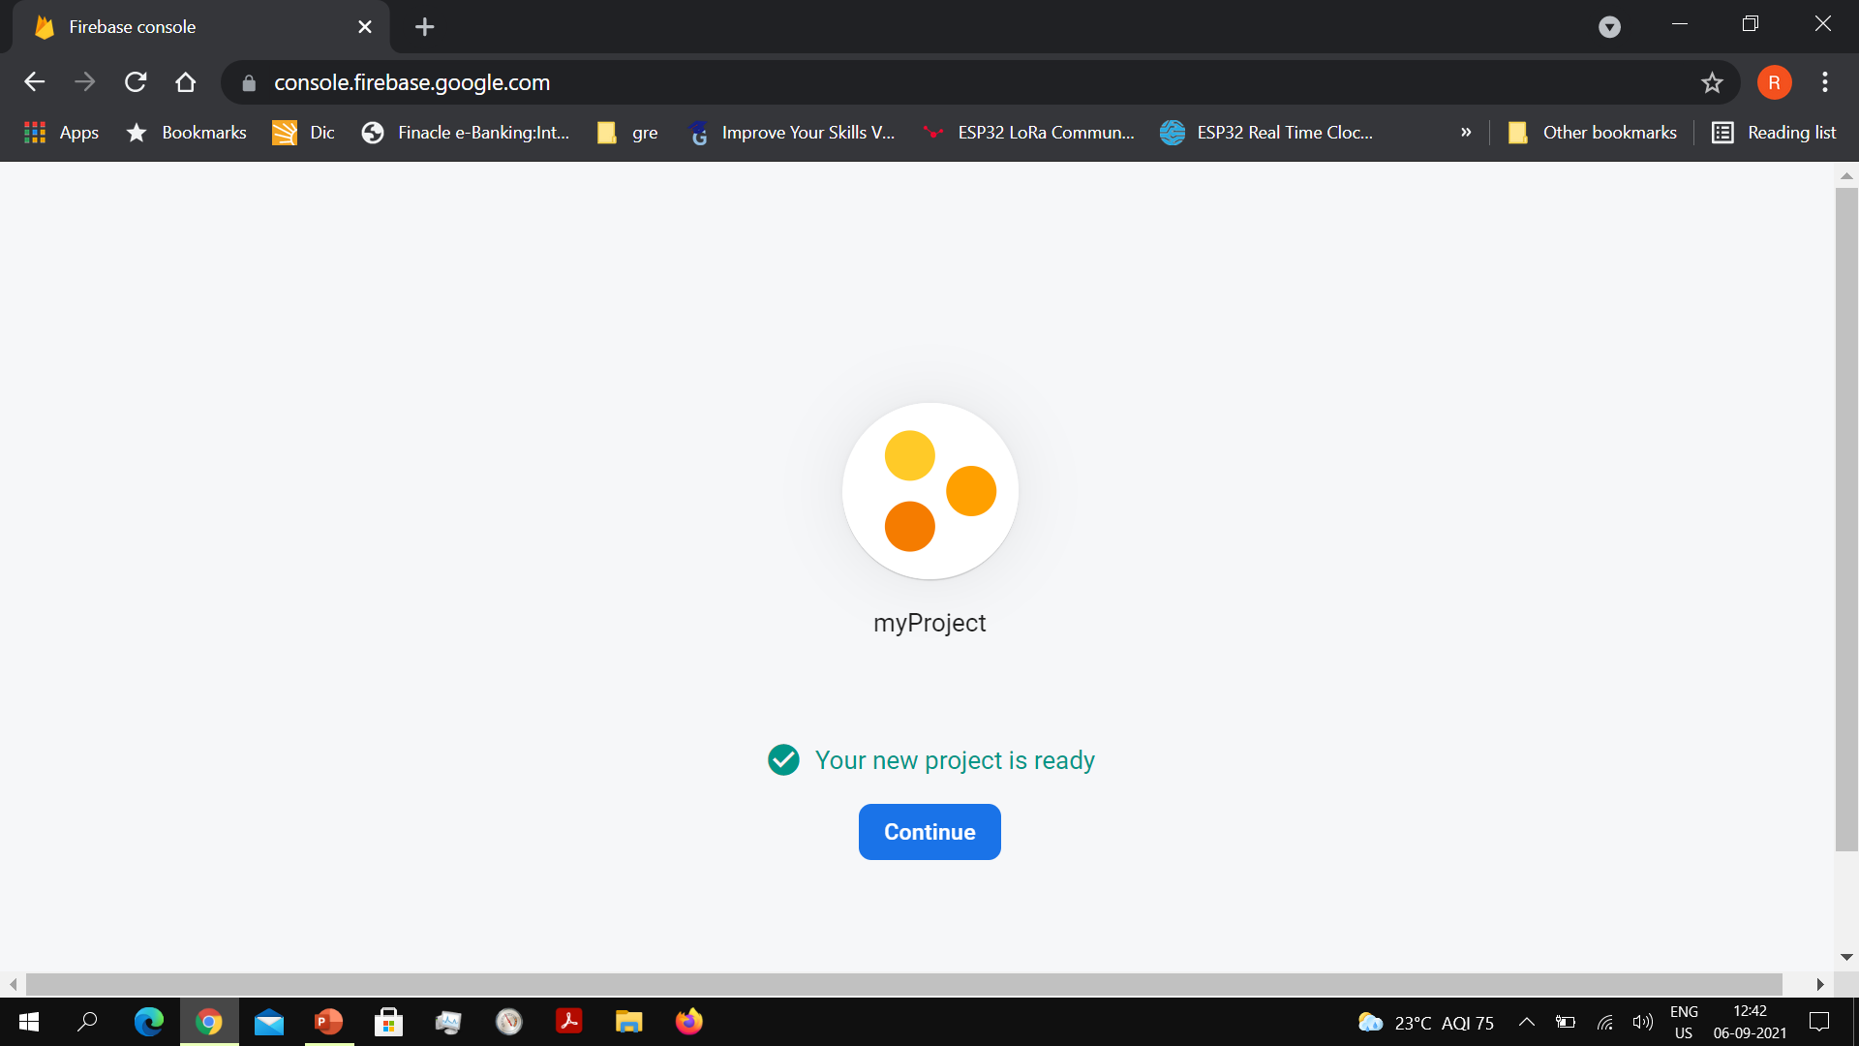

Slide 14
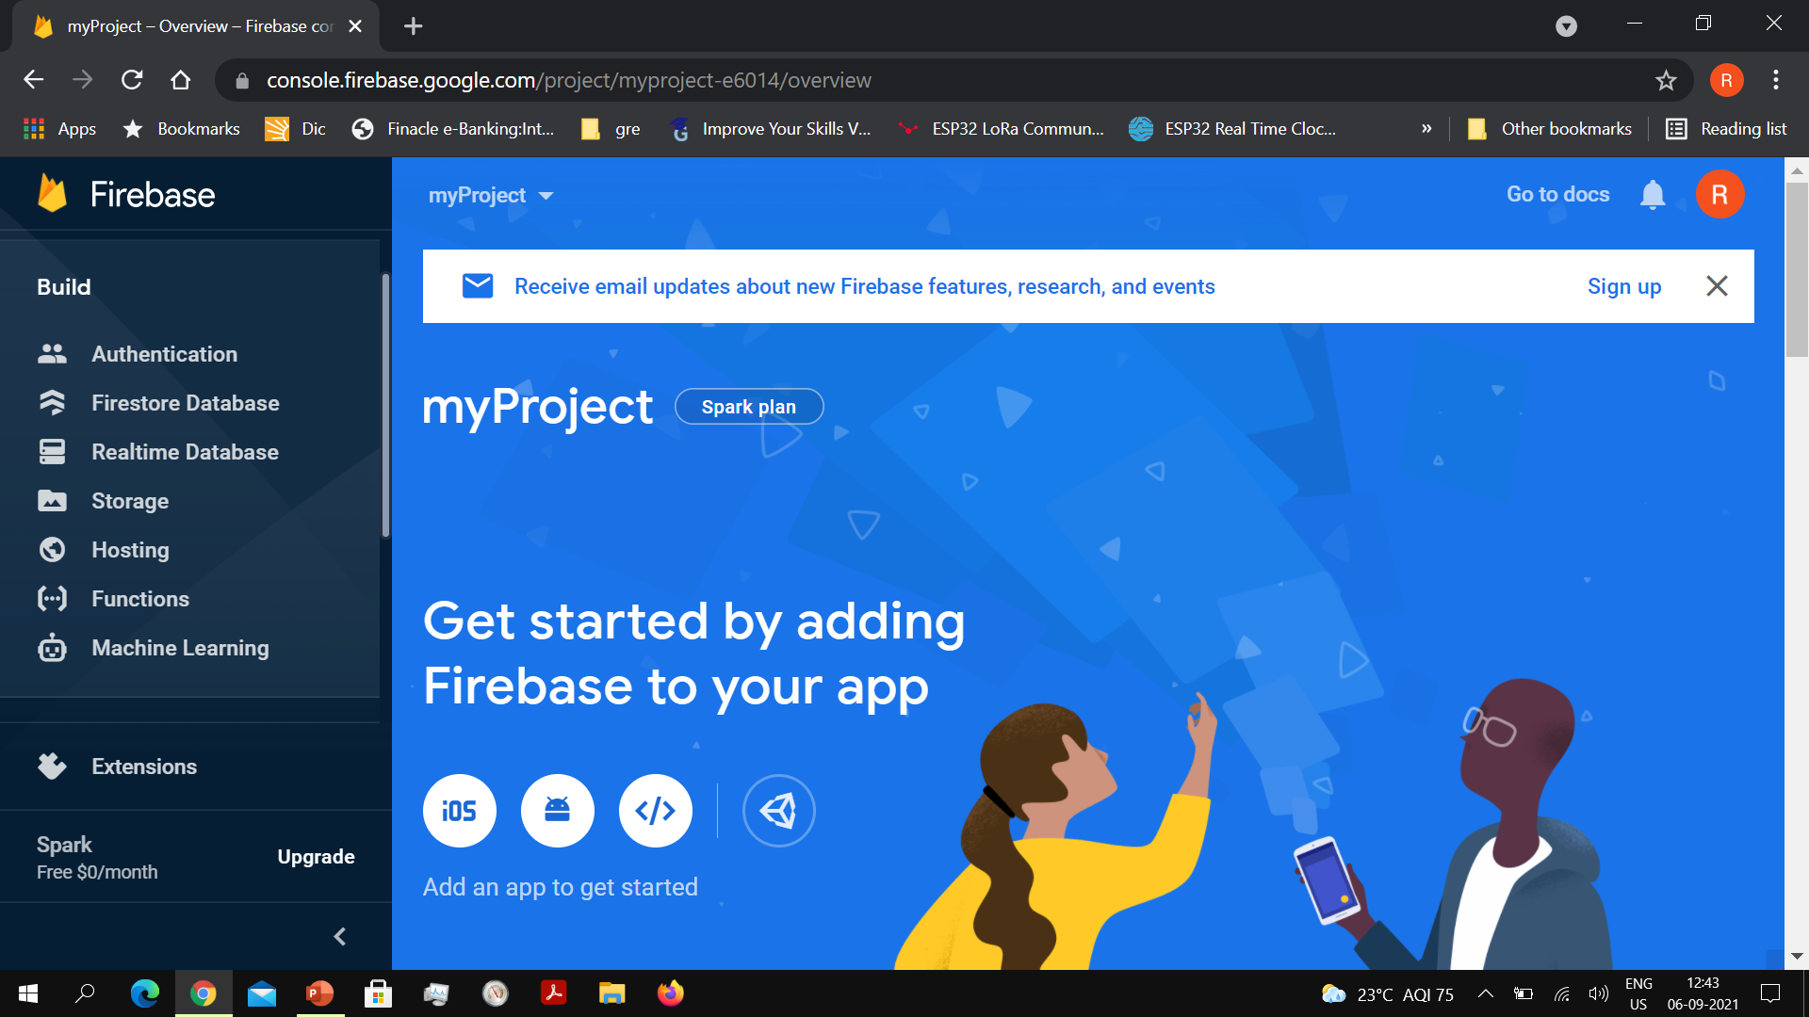
Go to the Build group in the left pane and select Realime Database

Slide 15
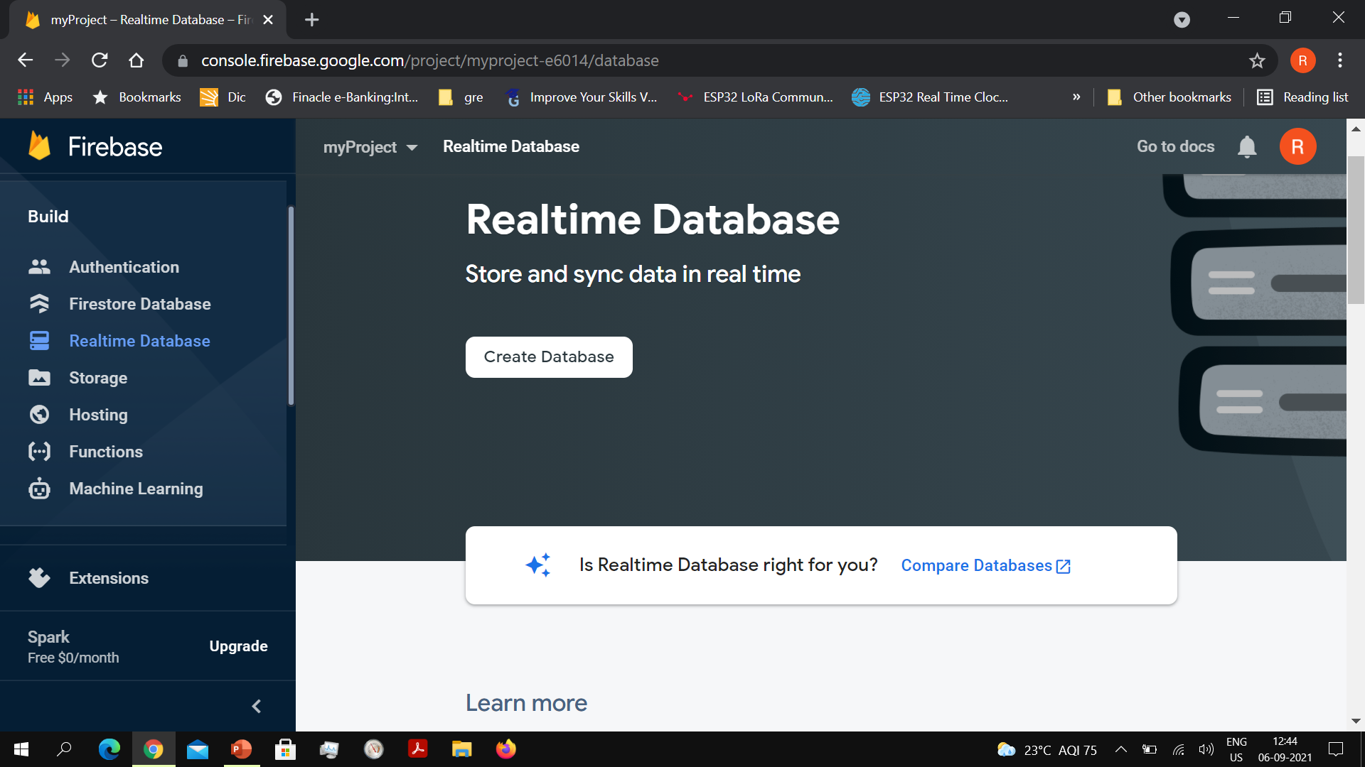
Click on the Create Database button

Slide 16
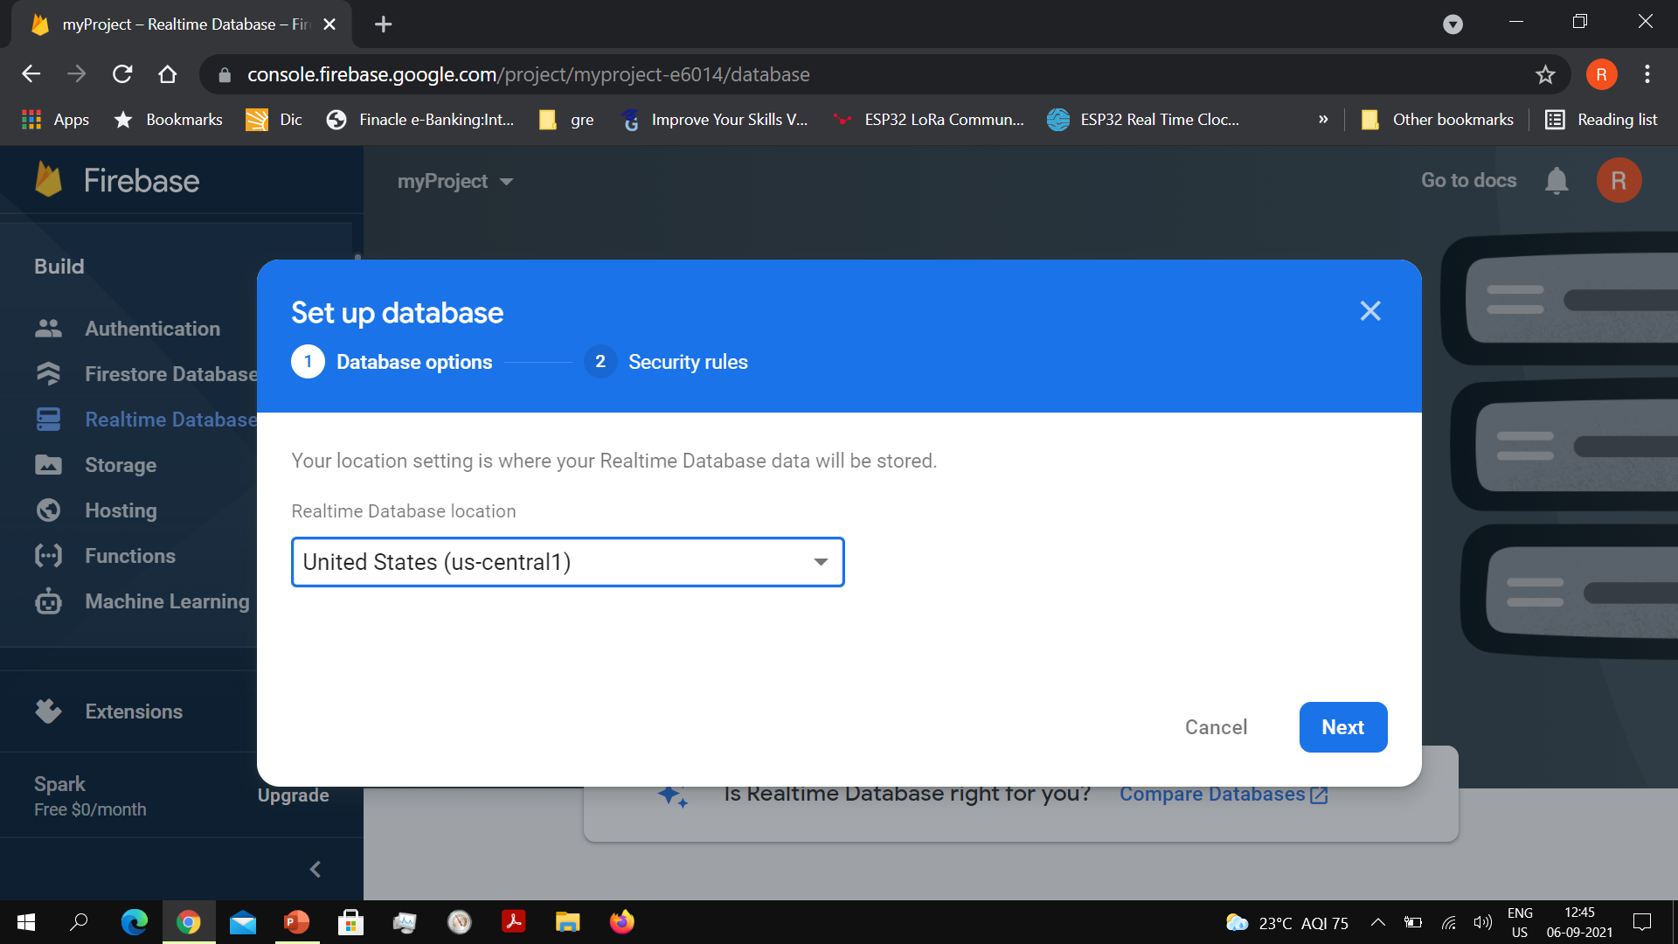

Slide 17
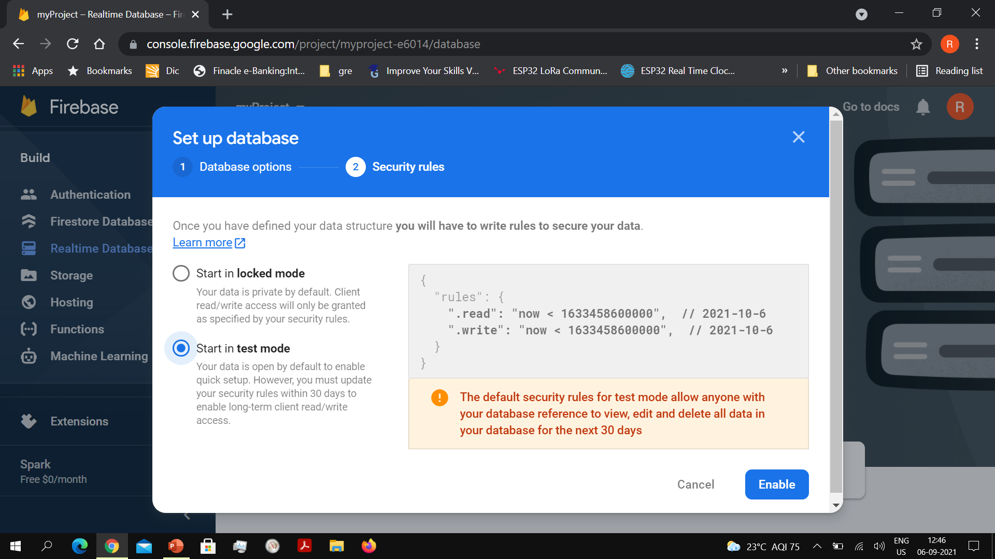

Start the database in Test Mode.
Default option will be in Locked mode

Slide 18
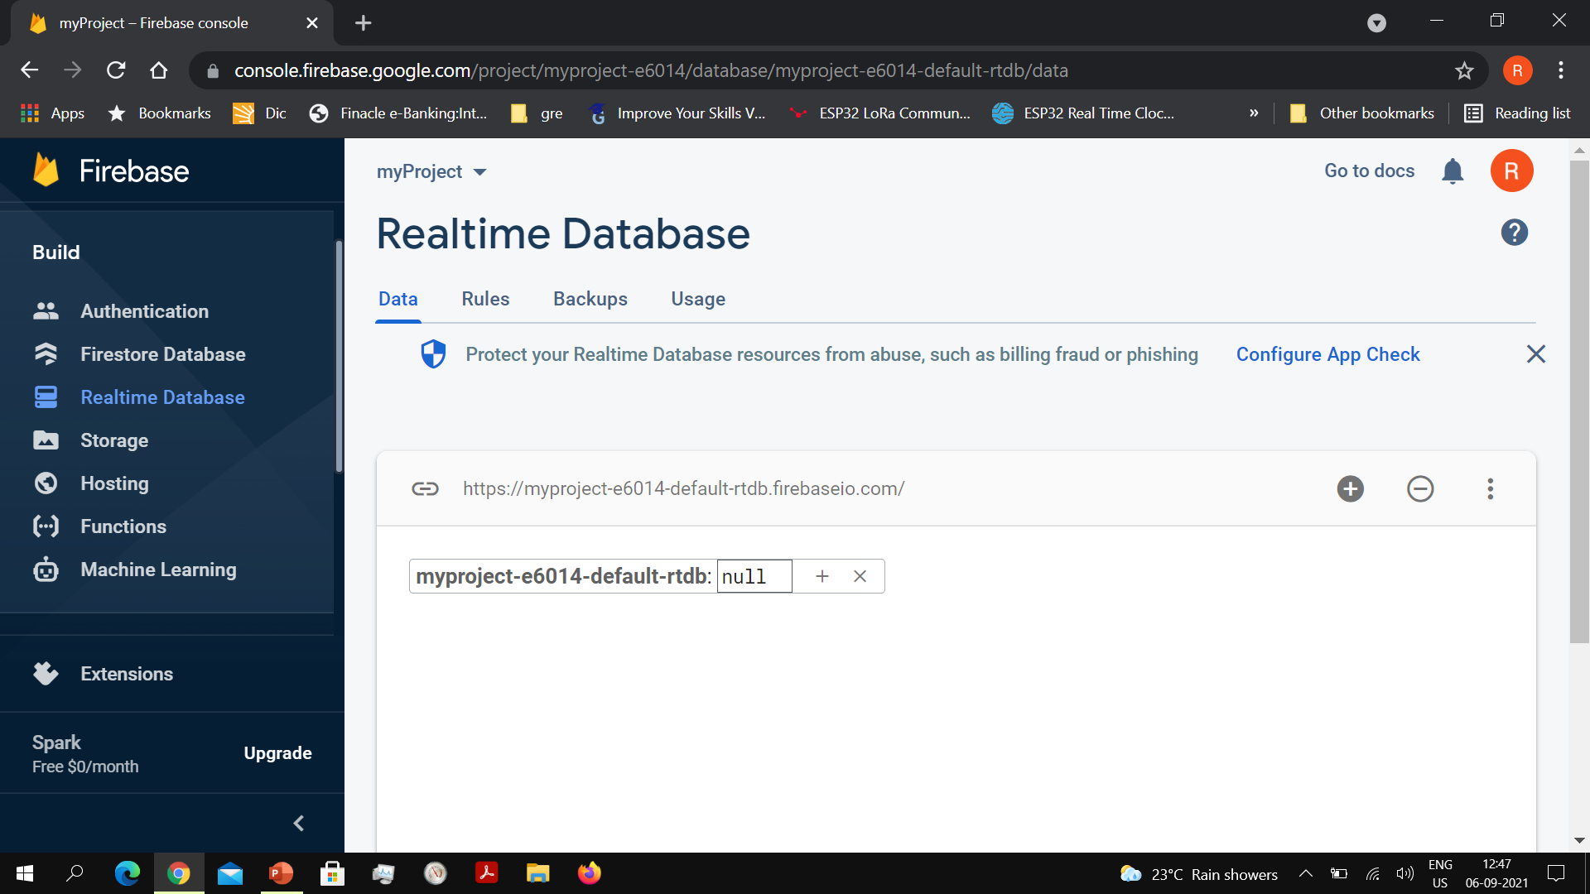
The host name/URL of your database

Slide 19
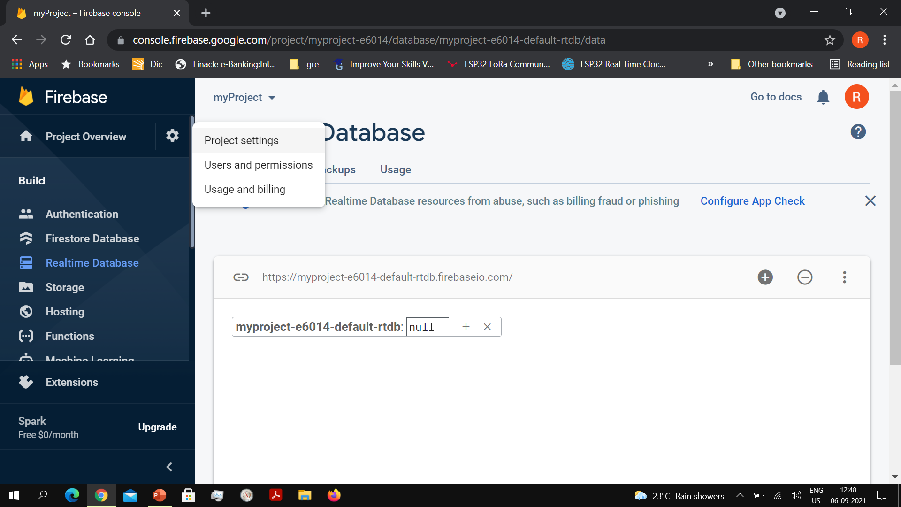

Slide 20
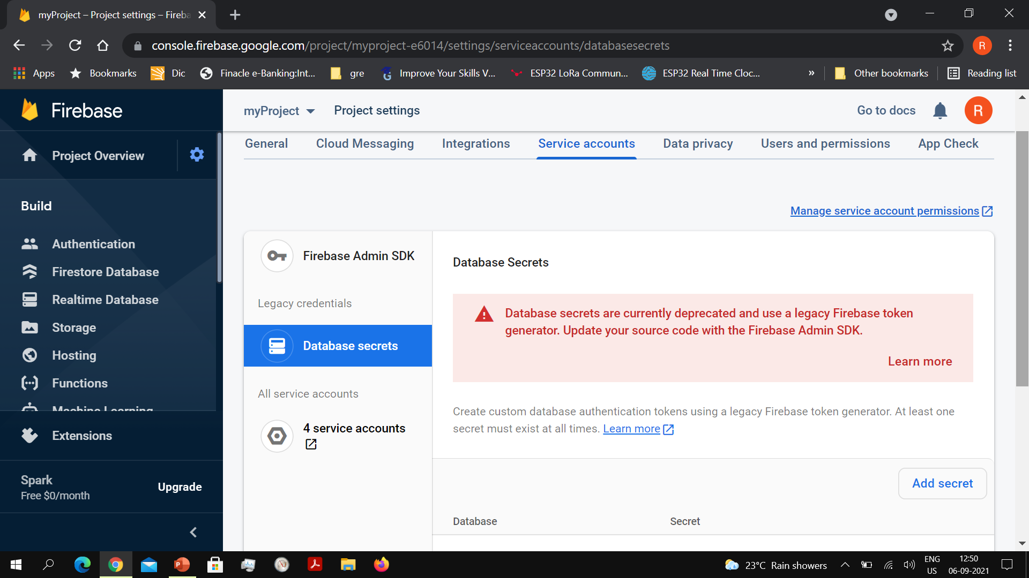
Click on Project Overview/Project Settings/Service Accounts/Database Secrets

Slide 21
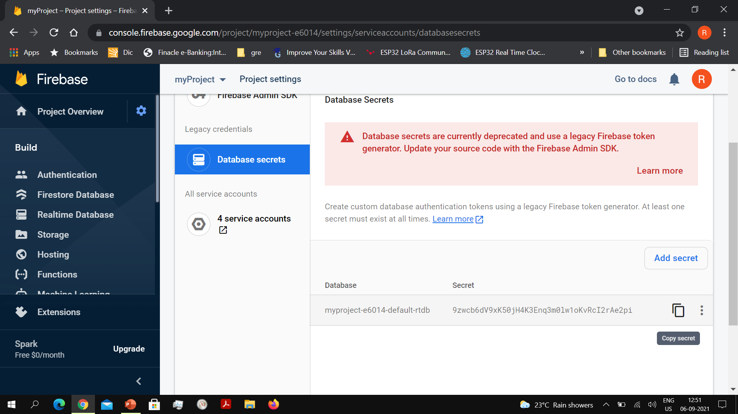
Copy database secret onto Clipboard

Slide 22
Google Firebase access using Arduino
#include < FirebaseESP32.h>//Arduino Firebase library for ESP32
#define FIREBASE_HOST “xxxxxxxxxxxxx.firebaseio.com”
#define FIREBASE_AUTH “xxxxxxxxxxxxxxxxxxxxxxxxxxx”
FirebaseData fbd;

Slide 23
Google Firebase access using Arduino
Key
Value
Firebase.begin(FIREBASE_HOST,FIREBASE_AUTH);
Firebase.setFloat(fbd,”IOTLAB/My_App/Sensor_Value”,value);
Firebase.getString(fbd,”IOTLAB/My_App/Motor_Cmd”,myString);
Pushing data
Pulling data

